Slide 1
Professions

Slide 2


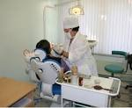

An operator
A doctor
A dentist
A secretary

Slide 3
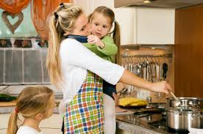
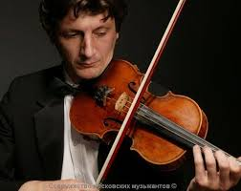

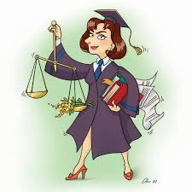
A housewife a musician
A bank manager
A lawyer

Slide 4
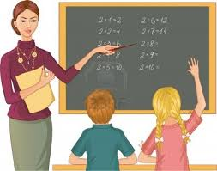

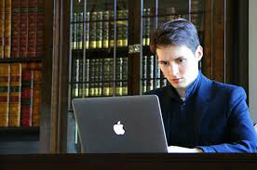

A teacher a driver
A computer
Programmer
A pilot

Slide 5


Is it a teacher?

Slide 6

Is it a doctor?

Slide 7

Is it a dentist?

Slide 8
A teacher | works in a school.
A writer | writes books.
A doctor | helps people.
A vet (veterinarian) | looks after animals.
A singer | sings song and play music.
A farmer | works on a farm.
An actor\actress | acts in plays\films.
A pilot | flies a plane.
A reporter | makes reports.
A sportsman | plays sports.
A police officer | wears uniform.

Slide 9
7. Correct the sentences.
1. Doctors teach children
2. A pilot drives a car.
3. A farmer works on a farm.
4. Teachers work at school.
5. A fireman brings letters.
6. A programmer fights fires.
7. Dancers work in the hospital.

